Slide 1
Relevant Real-World Undergraduate Research Problems: Lessons from the NSF-REU Trenches
Moderator:
Reynold Bailey
Panelists:
Guy-Alain Amoussou
Tiffany Barnes
Hans-Peter Bischof
Thomas Naps

Slide 2
NSF Research Experiences for Undergraduates Program (REU)
Supports active research participation by undergraduate students in all areas of research funded by the NSF
Two mechanisms for support:
REU Sites
REU Supplements

Slide 3
REU Sites
Based on independent proposals to conduct projects that engage undergraduate students in research
May be based in a single discipline or academic department, or on interdisciplinary or multi-department research opportunities as long as there is a coherent theme.

Slide 4
REU Supplements
May be requested for ongoing NSF-funded research projects
May be included as a component of proposals for new or renewal NSF grants

Slide 5
More about REU Funding
REU projects may be carried out during the summer, during the academic year, or both.
Summer research is typical especially for REU sites
REU Sites may be proposed for durations of one to five years.
Three years is typical
Students apply directly to the REU sites not to NSF

Slide 6
Goals of NSF REU Program
Expand student participation in all areas of research
Develop diverse, internationally competitive, and globally-engaged science and engineering workforce
Attract diverse pool of talented students into careers in science and engineering, including teaching and education research
Increase number of students interested in graduate programs
NSF strongly encourages women, underrepresented minorities, and persons with disabilities participate in REU opportunities.

Slide 7
Goals of NSF REU Program
To accomplish these goals and to provide meaningful experiences for students, REU research problems must be interesting and relevant.
They must also be of sufficient scope to allow for 8-10 weeks of active research.

Slide 8
Our Panelists will…
Describe their REU research problems
Highlight challenges they encountered
Present their results
Discuss what they have done, or what can be done, to incorporate such research problems within the regular computing curriculum

Slide 9
Introduction of Panelists
Guy-Alain Amoussou Humboldt State University
Tiffany Barnes University of North Carolina at Charlotte
Hans-Peter Bischof
Rochester Institute of Technology
Thomas Naps
University of Wisconsin - Oshkosh

Slide 10
Guy-Alain Amoussou Humboldt State University

Slide 11
REU-RMS at Humboldt State University
REU funded since 2005 by NSF and DoD
Overarching theme: Science of design
Interdisciplinary
Faculty: CS, engineering, graphic art, GIS/natural resources, math modeling
Students: CS, engineering, graphic art, physics, math modeling
10 weeks for 10 students
www.humboldt.edu/~reu-rms

Slide 12
REU-RMS at Humboldt State University
(1) Prepare …
Design and creativity activities, tutorials and workshops
(2) Practice …
Weekly forum (5 slides in 10 minutes), weekly startup, peer review
(3) Produce …
Poster, research paper, research symposium

Slide 13
REU-RMS at Humboldt State University
Project examples:
Development of Testing Software for Embedded Robotic Vision Systems
Coastal Management: A Computational Approach
Plasma Heating Simulation via Parallel Computing
Multi-Platform Real-Time Collaborative Sketching

Slide 14
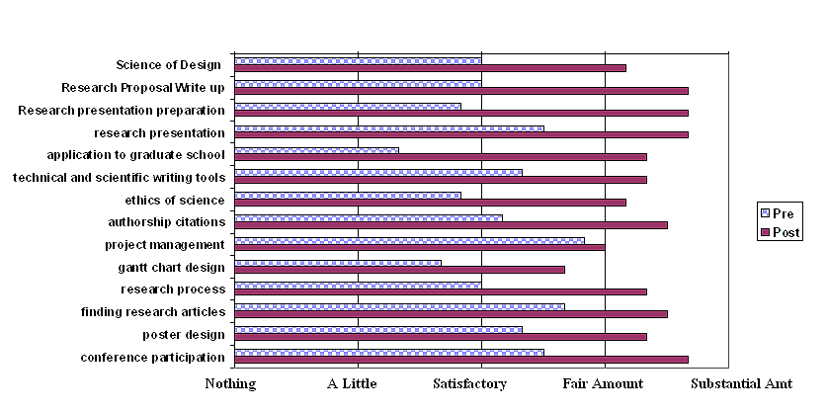
REU-RMS at Humboldt State University
Lessons Learned:

Slide 15
REU-RMS at Humboldt State University
Lessons learned
Need for teaching design and creativity
Writing short and longer papers
Interdisciplinary activities
Generalized to capstone courses or senior projects"

Slide 16
Tiffany Barnes University of North Carolina at Charlotte

Slide 17
Hans-Peter Bischof
Rochester Institute of Technology

Slide 18
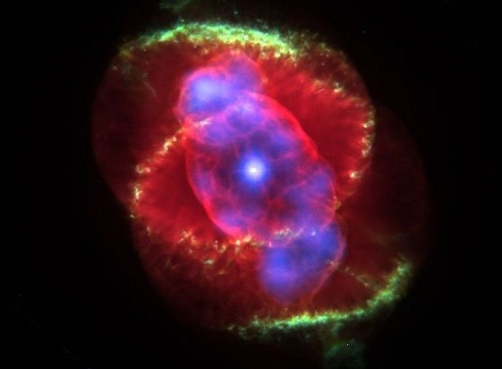
Problem Statement
We have scientific data – a lot of it!
Convert to:

Slide 19
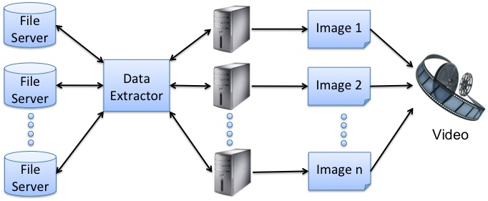
Problem Statement
And develop a high performance file system

Slide 20
Old Framework
Simple IO
n images
OpenGL
Video
Data file(s)

Slide 21
REU Projects
Sonification
Audio file
HPFS
Video with Audio
n images
Data file(s)
RenderMan

Slide 22
Visualization Examples

Slide 23
Visualization Examples

Slide 24
Visualization Examples

Slide 25
Lesson’s Learned: Preparation
Administrative help
Dean’s office / your department
Involve them early
Documents they know and can provide
Insurance
Travel release forms
Room and board
Lab / dorm access
Resources
REU’s are a prestige for your chair/dean
Make it public
Do not be shy to ask for resources

Slide 26
Lesson’s Learned: Admission
Technical skill set is difficult to estimate
Scalable Projects
Social skills
Letters of Reference may not be too helpful
Call a reference
Reason for attending your REU
Students excitement about working on research projects may not come to reality

Slide 27
Lesson’s Learned: 10 Weeks
They are not like you
When you worked on your Ph.D.
They need time off
Plans for entertaining
Movies
Trips to interesting places
Spend time outside ‘research world’ with them
But, you do not babysit them

Slide 28
Lesson’s Learned: Afterwards
Contract of expectations
Mix between local and ‘away’ students
Local students help provide avenues for social interaction on evenings and weekends
Report
In week 11
Not everything goes as planned
Work in a team
4 faculty
2 staff

Slide 29
Personal Conclusion
8 weeks would have been better
I learned that Rennie is great chef
Be prepared for emergencies
Loss of partners
Loss of family members
It is not automatically your fault

Slide 30
Tom Naps
University of Wisconsin - Oshkosh

Slide 31
EXPLORING OPEN SOURCE SOFTWARE: DEVELOPMENT AND EFFICACY OF ONLINE LEARNING ENVIRONMENTS IN COMPUTER SCIENCE David Furcy and Tom Naps, UWis - Oshkosh
Cornerstone is JHAVE, a large open-source algorithm visualization delivery system on which both David and I have invested large amounts of our research time over the years. That includes working with a lot (20+) of our own local students – one of the key reasons why we felt might provide a rich REU experience
Along with AV, try to develop effective “hypertextbook” environments in which the AV is integrated to provide an effective learning experience. In particular see how open-source CMS’s such as Drupal and Moodle might be augmented to provide such AV-based hypertextbooks
Understand what makes AV effective as a learning tool
Be able to construct experiments that can be used to measure the effectiveness of particular AV’s
We tried to “sell” what students would be doing as an opportunity to help their fellow CS students learn difficult material

Slide 32
“Schedule” of what we did with our participants
~10 days to get them up to speed in:
Understanding the history of research in AV
Learning how to plug into our system to create an AV
By end of second week, each team of two had to write a research proposal, which we discussed individually with them and “approved” after appropriate revisions
They had to present storyboards of how a learner would interact with their AV before we gave them the go-ahead to actually start coding it
Next six weeks were heavy on the software development aspect of what goes into creating an AV
Concurrently they were authoring their hypertextbook materials for the AV.
David and I met with each team every other day to discuss progress
Ended with a practice “poster session” that was to be a dress rehearsal for …
The posters they would submit and present at the fall meeting of CCSC Midwest in Chicago. Travel support to such an event, if their poster was accepted, was part of our proposal. Seven of our eight participants took advantage of this.

Slide 33
Our collaborators from other institutions played a huge role
Myles McNally from Alma College
AV development support, particularly on those components of JHAVE that he had authored
Poster reviewer at end of summer
Cliff Shaffer from Virginia Tech
Mid-project feedback sessions with our students
Session on what to expect should you apply for and be accepted into a Ph.D. program at an R1-research institution
Susan Rodger from Duke
Overview of her work with the very successful JFLAP system
Poster review at end of summer
Brian Paul of VMWare (and Tungsten Graphics) and winner of the FSF’s developer of the year award in 2001 for his work on the MESA implementation of OpenGL
Session on where open-source development can lead outside of the grad school research route that we had been emphasizing
Poster reviewer at end

Slide 34
What have we learned?
Begin planning for the coming summer as early as possible. (This year we will!:-)
If you’re coming from a strictly undergraduate institution, don’t think your REU participants will be the research assistants your colleagues at R1 schools employ.
Be prepared for a variety of backgrounds in terms of students’ abilities to do the work you have in mind. Have a flexibility in your projects that takes that into account.
If what you’ve always wanted to do is show students how much doing research means to you, expect an enriching, but hectic, summer

